Slide 1
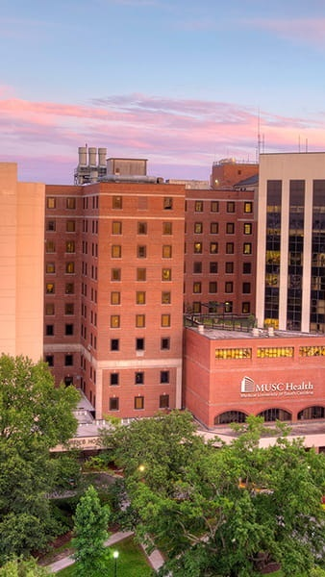
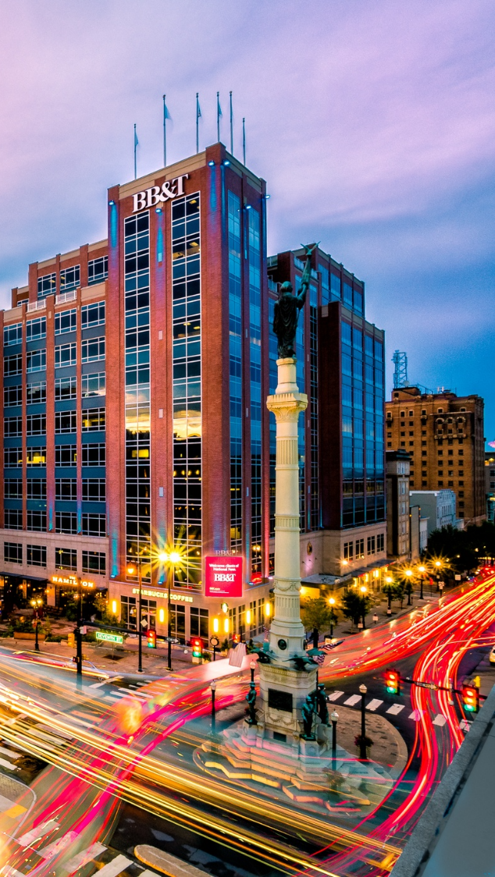

OPPORTUNITY REVIEW
DIRECT-TO-EMPLOYER GTM STRATEGY
Exploring a MUSC DTE Health Plan

Slide 2
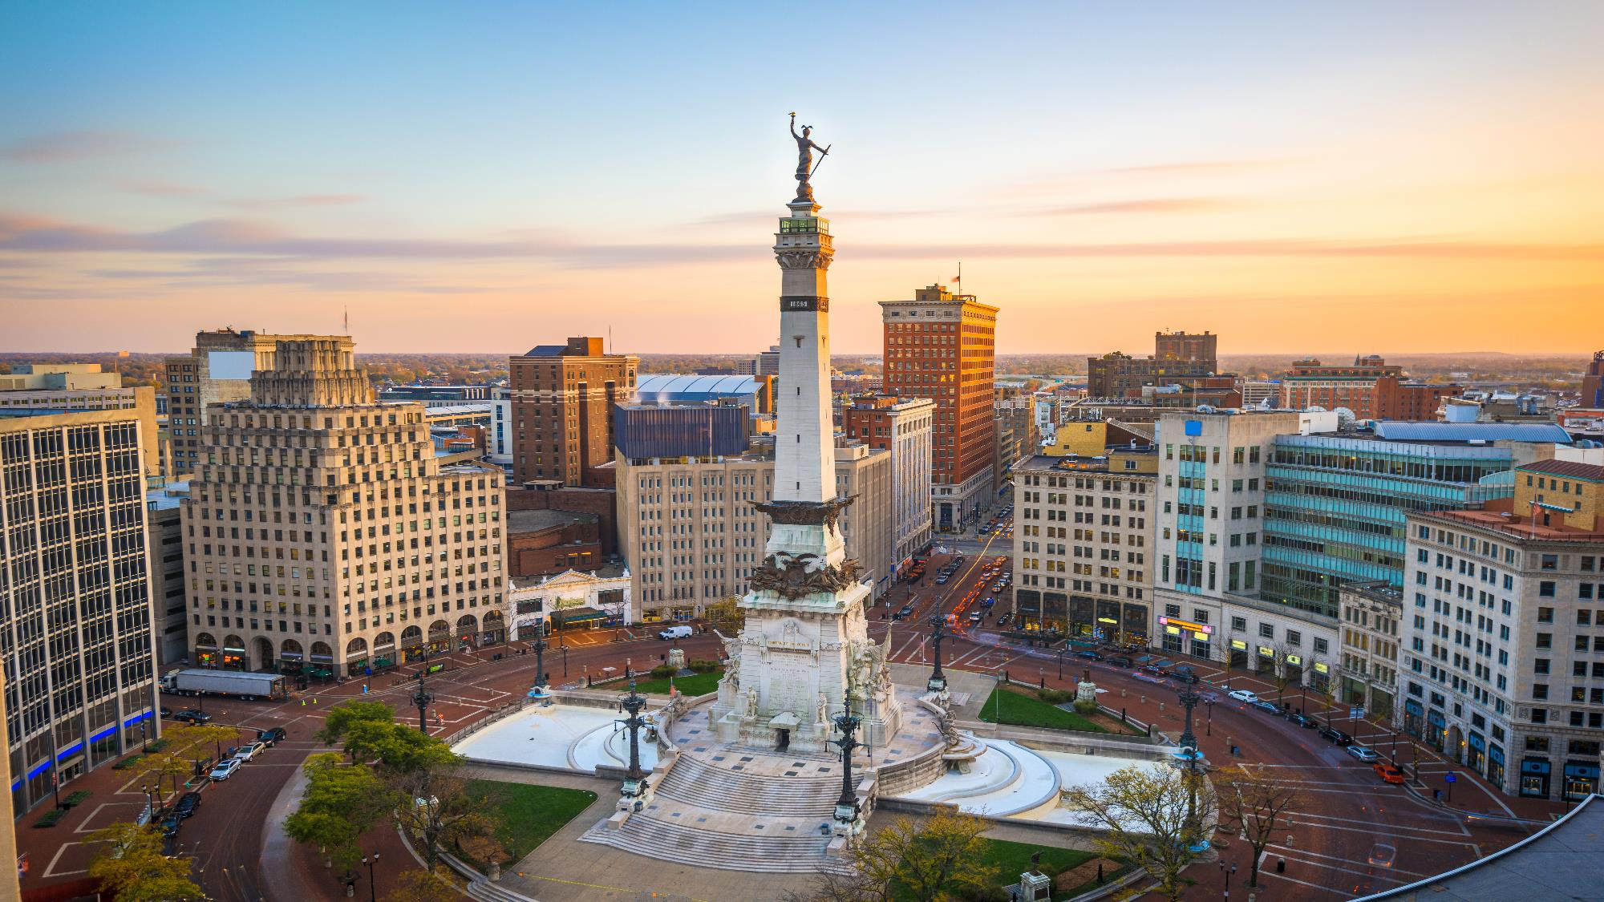

Founded in 1979, headquartered in Indianapolis
Largest Independently-Owned Full-Service Third-Party Administrator
Specialize in Administration of Self-Funded Plans and Population Health Management​
Leader in the Direct-to-Employer Movement
We Know and Understand the Market
Experience Working with All Professional Teams: Agents, Networks, MGAs
The Key Family of Companies is a Vertically Integrated group of benefit related organizations
3,000+ Corporate Clients
3 Million Members under Management
700 Employees

Slide 3


MARKET LEADER
IN
PRIVATE LABELED
DTE PLANS
Louisville, KY
OneHealth Plan
Cincinnati, OH
TCH Optimal
Bentonville, AR
Ozarks Community Choice
Knoxville, TN
East Tennessee Health Plan
Meridian, MS
Affinity Health Plan
Fort Myers, FL
Lee Health Care Partners

Slide 4
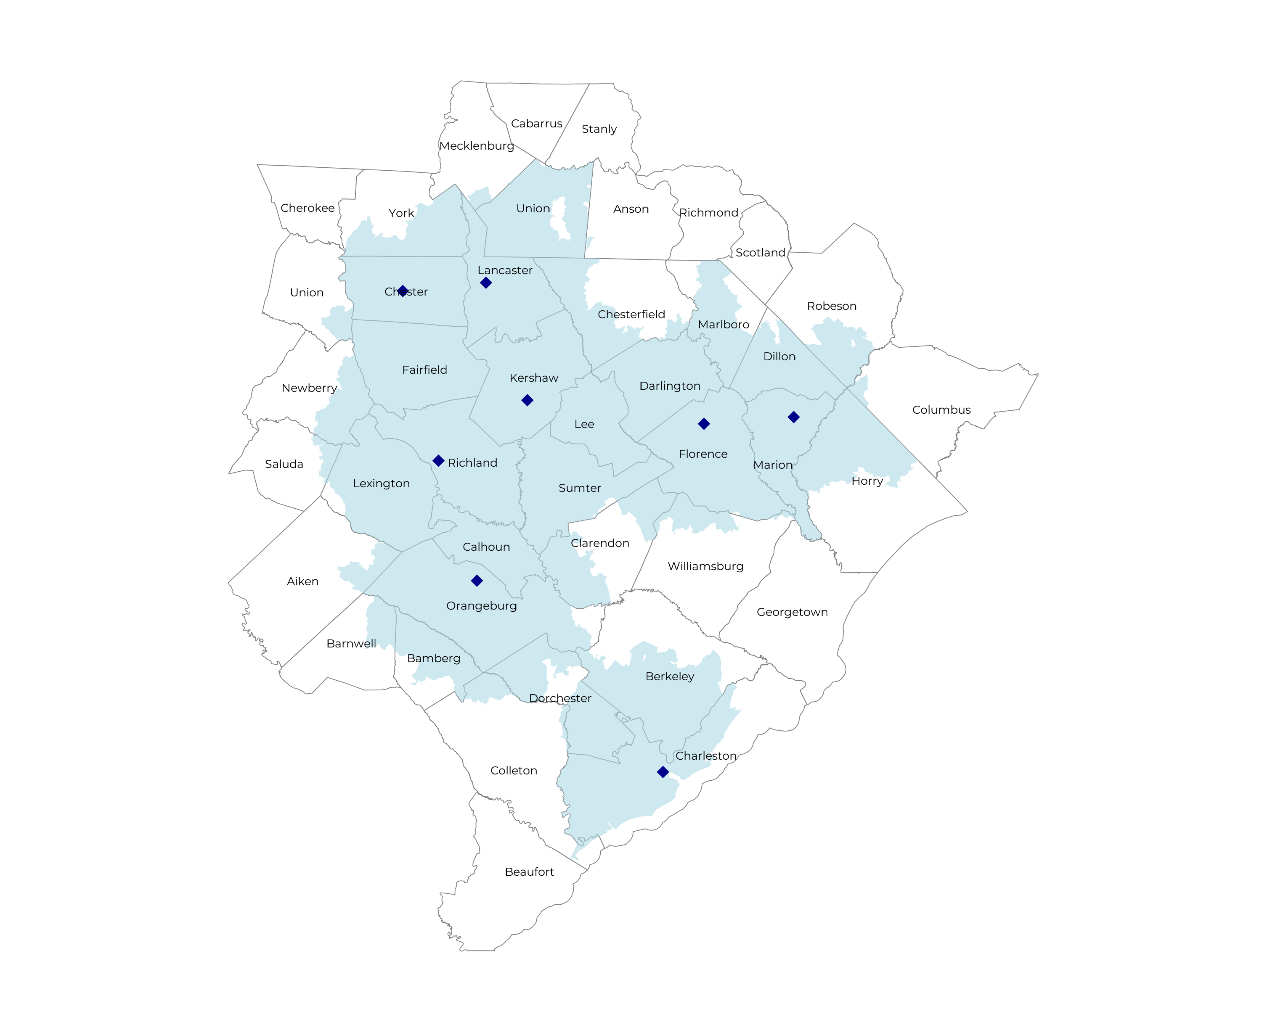
SIGNIFICANT OPPORTUNITY FOR PLAN GROWTH Researched for the below highlighted service area
Target Market 900+ Employers 120,000+ Employees 190,000+ Members
 | Employer Size Group (# of Employees)
Commercial Employers With Headquarters | 50-100 | 101-200 | 201-400 | 401-1,000 | 1,001-3,000 | 3,000+
In Catchment Area | 1,417 | 574 | 351 | 205 | 74 | 52
Total Employees at Employers | 50-100 | 101-200 | 201-400 | 401-1,000 | 1,001-3,000 | 3,000+
Headquartered in Catchment Area | 106,300 | 86,100 | 105,300 | 143,500 | 148,000 | 312,000
Total Members with Employers | 50-100 | 101-200 | 201-400 | 401-1,000 | 1,001-3,000 | 3,000+
Headquartered in Catchment Area | 191,300 | 155,000 | 189,500 | 258,300 | 266,400 | 561,600

Slide 5
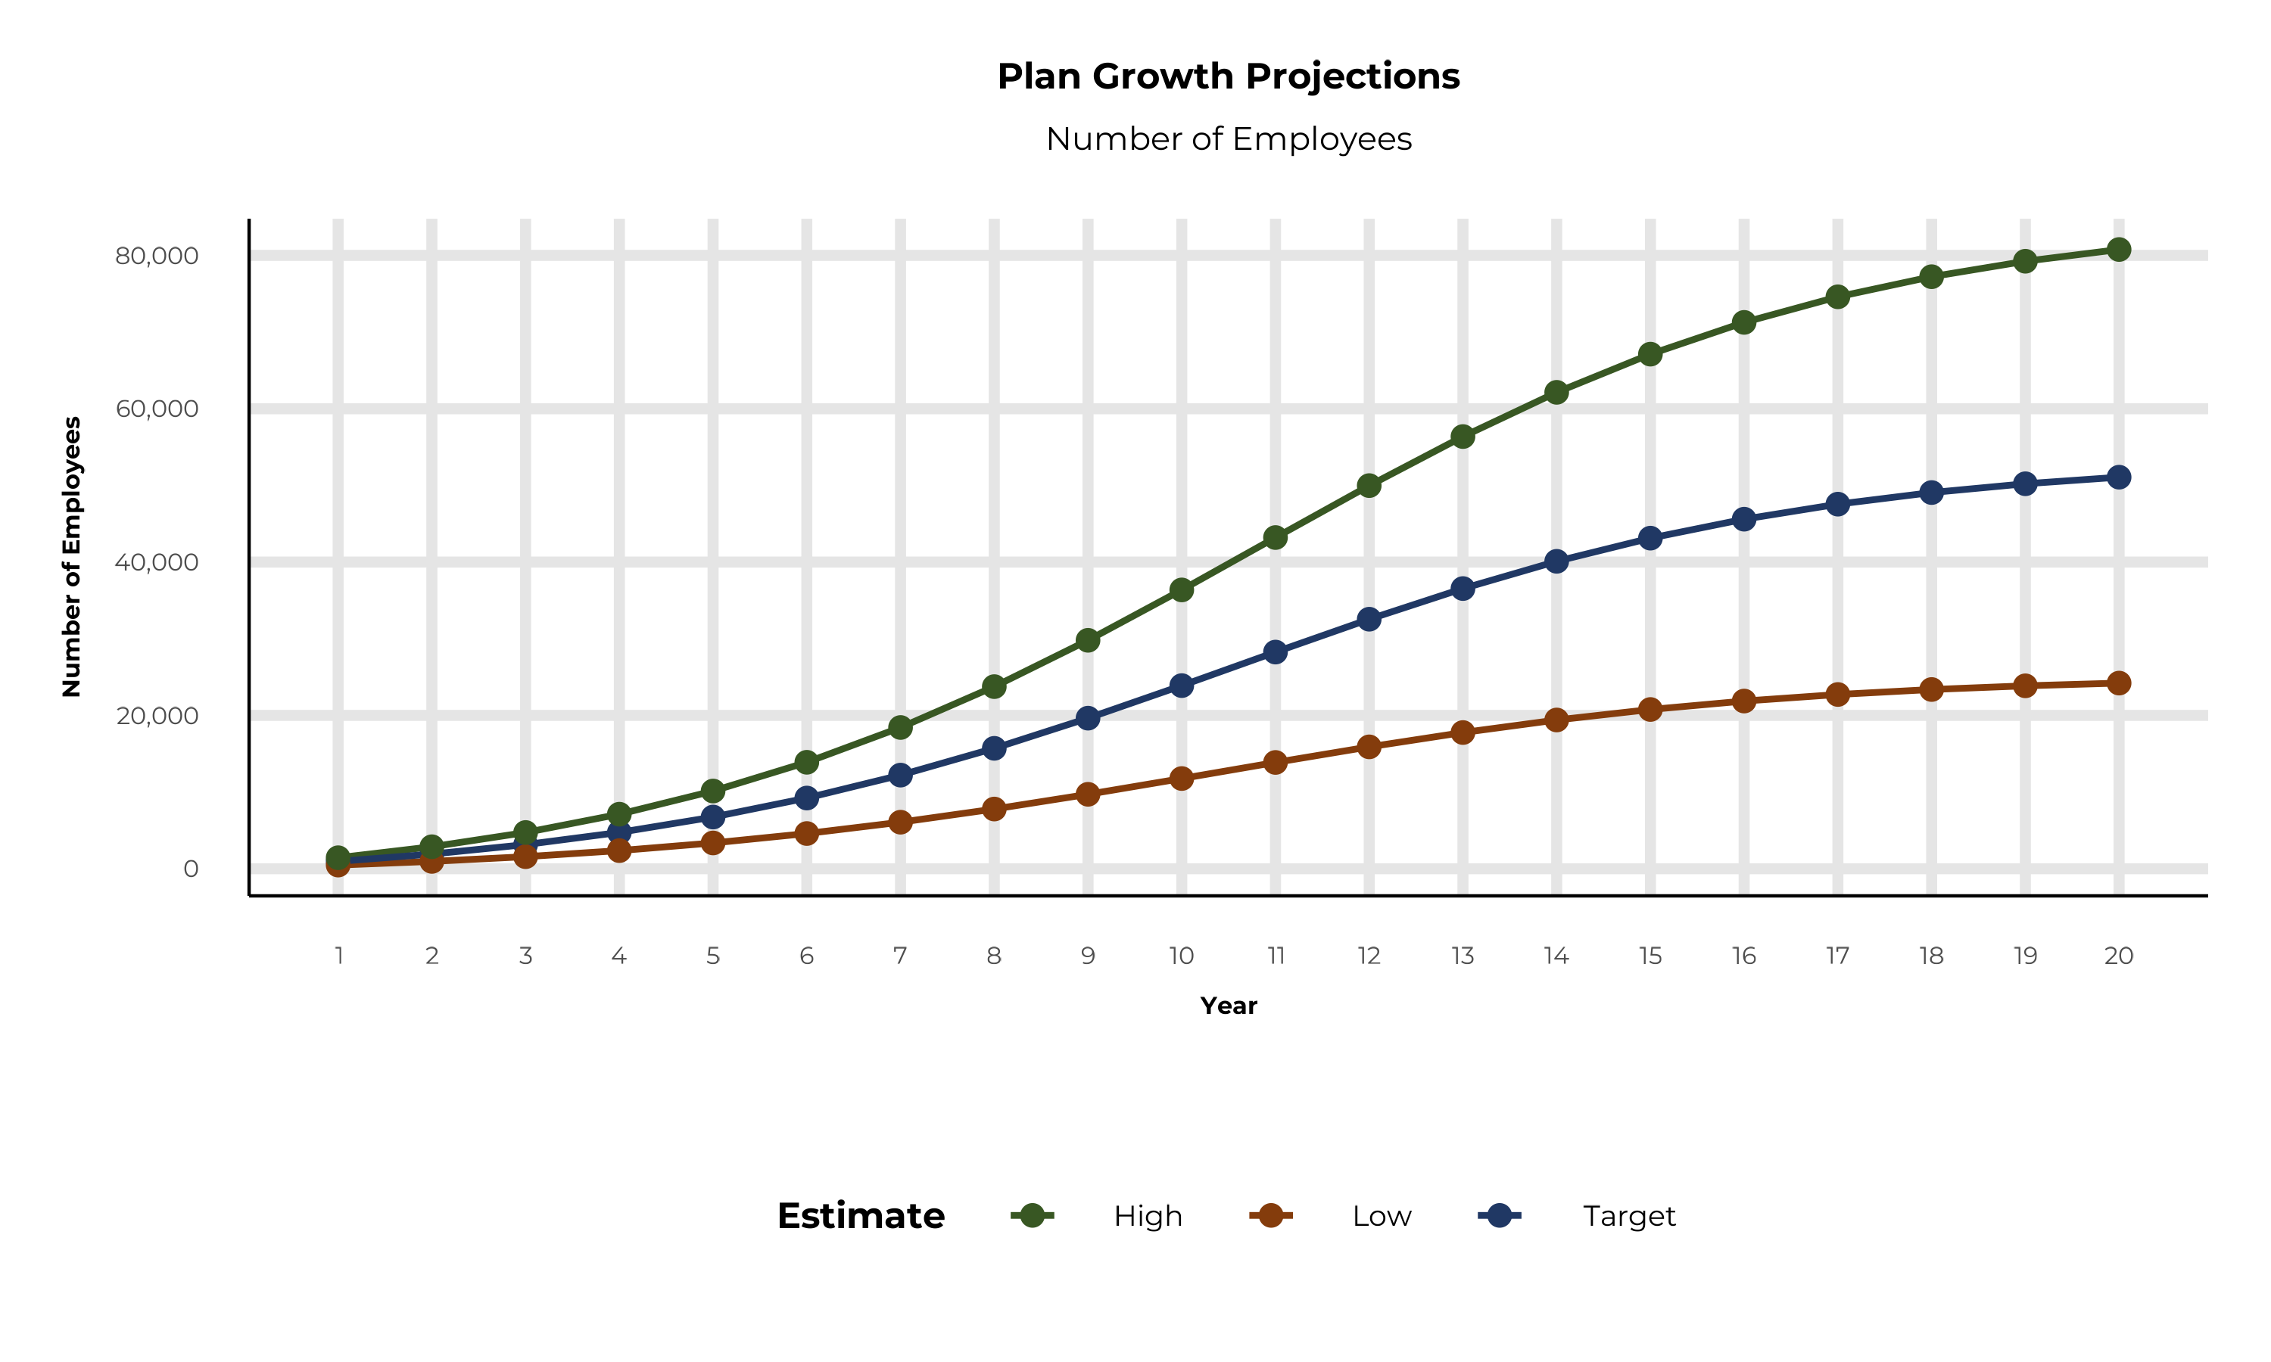
PLAN POTENTIAL GROWTH PATHS
Self Funded
700K
Insured
1,104K
Working Age
1,628K
Population
2,801K
Estimates includes the MUSC service area in Columbus, Mecklenburg, Robeson, Union, Aiken, Bamberg, Barnwell, Berkeley, Calhoun, Charleston, Chester, Chesterfield, Clarendon, Colleton, Darlington, Dillon, Dorchester, Fairfield, Florence, Horry, Kershaw, Lancaster, Lee, Lexington, Marion, Marlboro, Newberry, Orangeburg, Richland, Sumter, Williamsburg, and York Counties

Slide 6
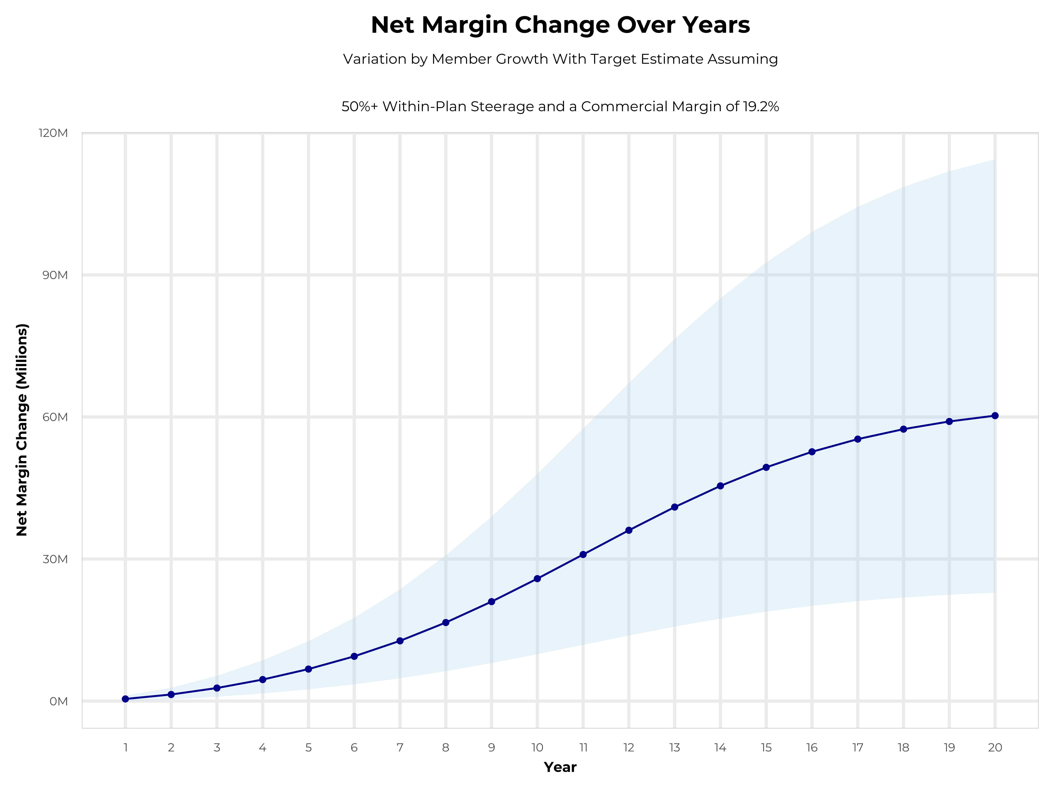
GROWING POWERFUL, LASTING PROFITABILITY
Early Stage
Gaining Name Recognition, Early Growth
New Revenue:
New Profit:
$22.56M
$4.23M
Growth Stage
Strong Reputation, Strong Growth
New Revenue:
New Profit:
$134.98M
$26.32M
Mature Stage
High Profitability, Market Saturation
New Revenue:
New Profit:
$277.52M
$54.22M

Slide 7
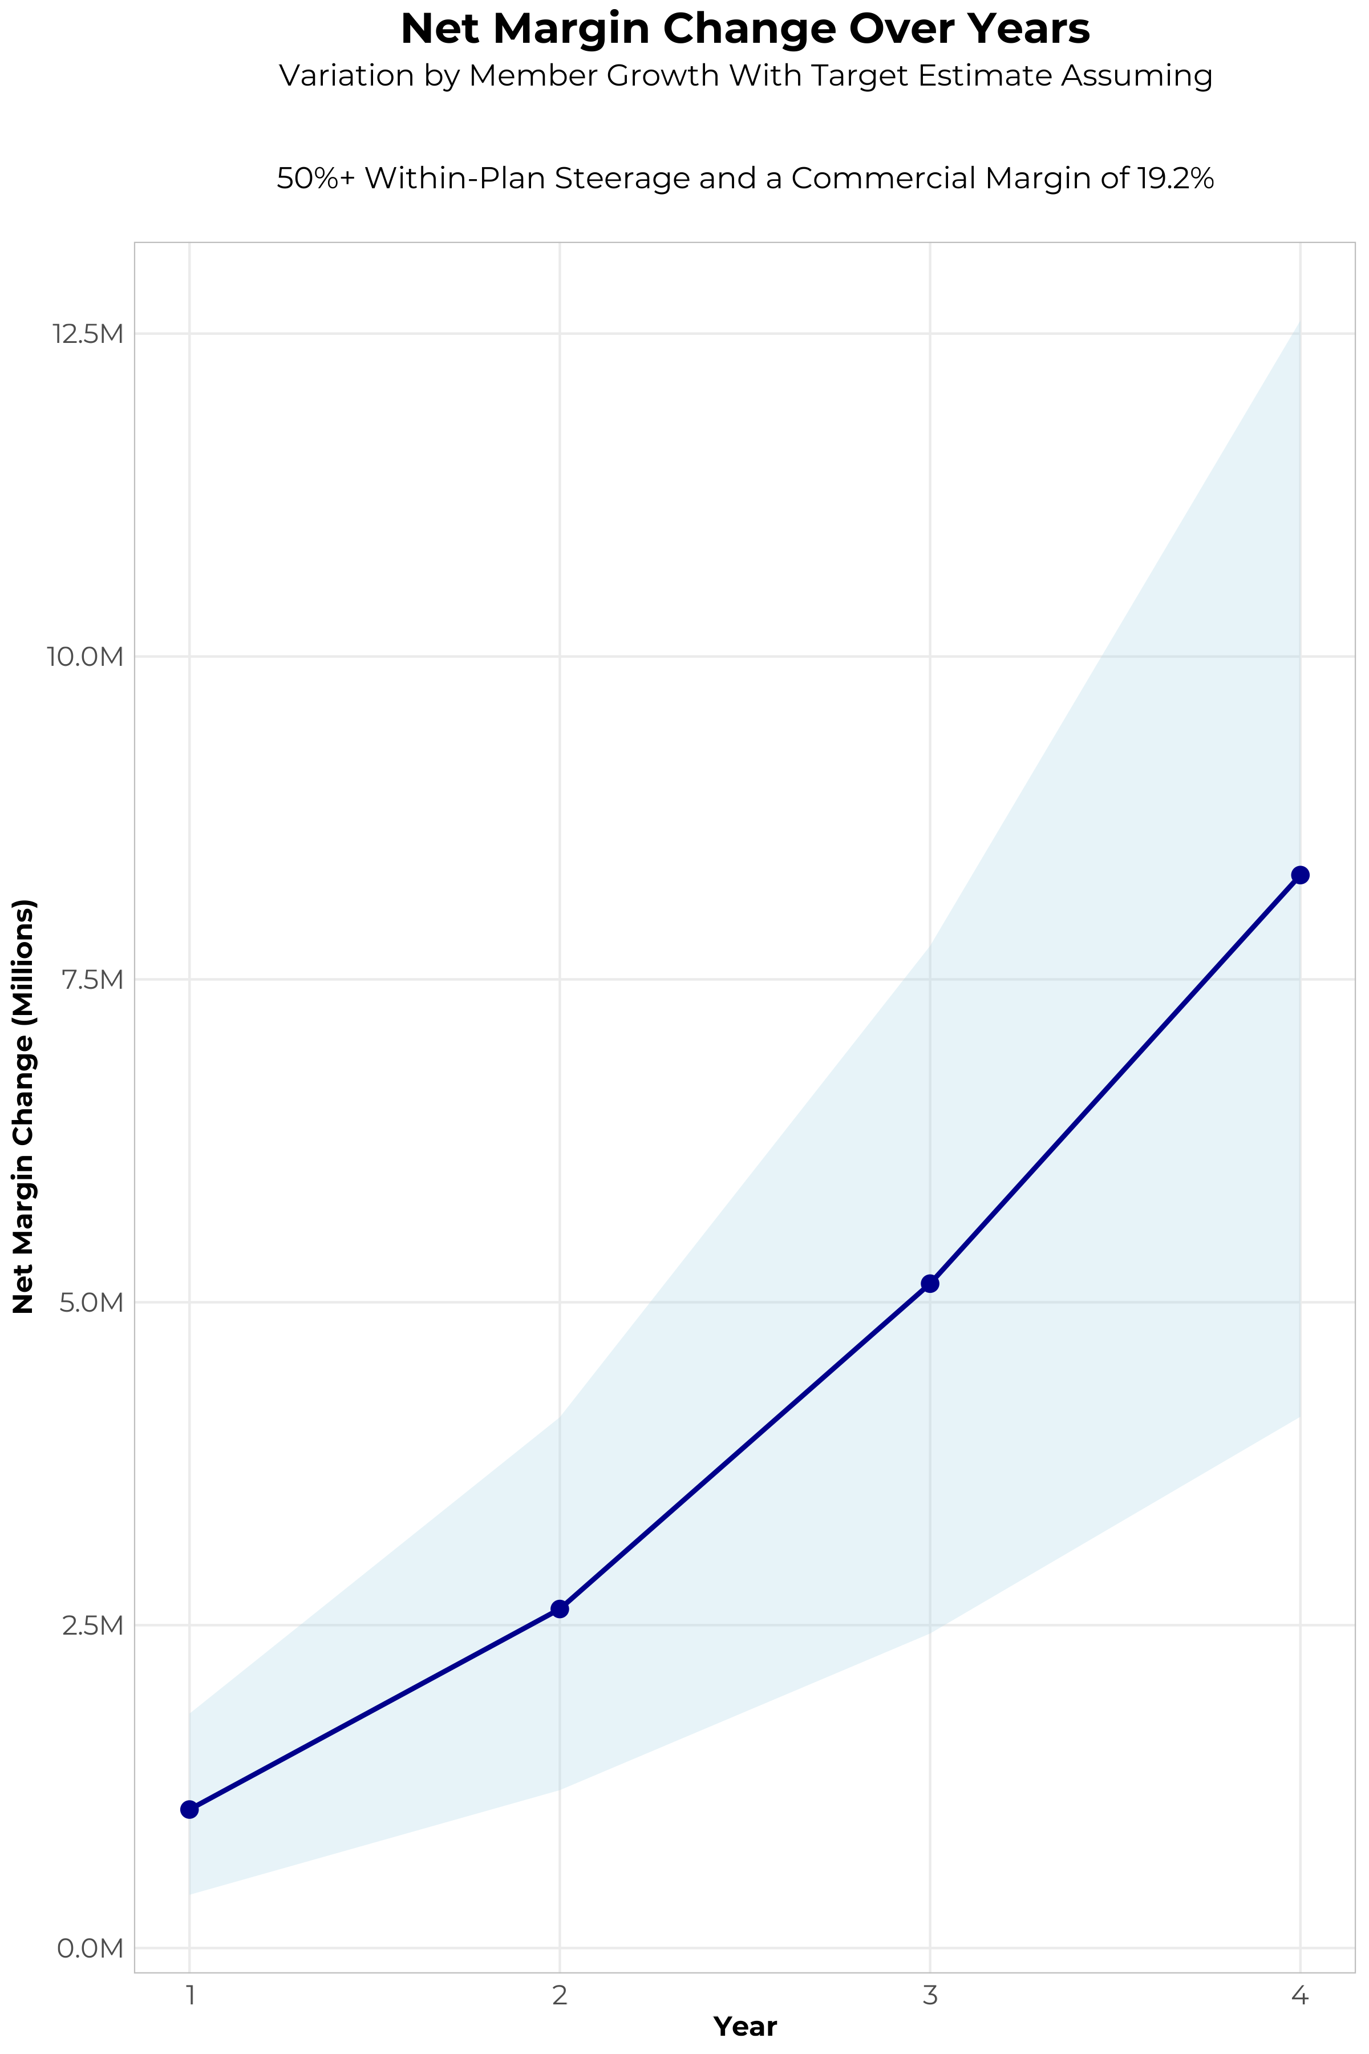
FOUR-YEAR PROJECTIONS
Target Member Growth | Target Member Growth | Target Member Growth | Target Member Growth | Target Member Growth
Metric | Year 1 | Year 2 | Year 3 | Year 4
Number of Members | 1,700 | 3,400 | 5,700 | 8,500
Incremental Margin | 1,382.1K | 2,764.3K | 5,255.8K | 8,385.7K
Network Access Fee | 20.4K | 40.8K | 68.4K | 102.0K
Implementation Fee (One-Time) | -150.0K | 0.0K | 0.0K | 0.0K
Sales and Marketing Costs | -180.0K | -180.0K | -180.0K | -180.0K
Net Margin Change | 1,072.5K | 2,625.1K | 5,144.2K | 8,307.7K
High Member Growth | High Member Growth | High Member Growth | High Member Growth | High Member Growth
Metric | Year 1 | Year 2 | Year 3 | Year 4
Number of Members | 2,600 | 5,200 | 8,500 | 12,800
Incremental Margin | 2,113.9K | 4,227.7K | 7,837.7K | 12,627.8K
Network Access Fee | 31.2K | 62.4K | 102.0K | 153.6K
Implementation Fee (One-Time) | -150.0K | 0.0K | 0.0K | 0.0K
Sales and Marketing Costs | -180.0K | -180.0K | -180.0K | -180.0K
Net Margin Change | 1,815.1K | 4,110.1K | 7,759.7K | 12,601.4K
Low Member Growth | Low Member Growth | Low Member Growth | Low Member Growth | Low Member Growth
Metric | Year 1 | Year 2 | Year 3 | Year 4
Number of Members | 900 | 1,700 | 2,800 | 4,300
Incremental Margin | 731.7K | 1,382.1K | 2,581.8K | 4,242.2K
Network Access Fee | 10.8K | 20.4K | 33.6K | 51.6K
Implementation Fee (One-Time) | -150.0K | 0.0K | 0.0K | 0.0K
Sales and Marketing Costs | -180.0K | -180.0K | -180.0K | -180.0K
Net Margin Change | 412.5K | 1,222.5K | 2,435.4K | 4,113.8K

Slide 8
PROJECTED PLAN GROWTH
Year | Employees | Members | Percent of Members Choosing MUSC for Inpatient Care | Percent of Members Choosing MUSC for Outpatient Care
1 | 1,000 | 1,800 | 60% | 50%
2 | 1,900 | 3,400 | 60% | 50%
3 | 3,200 | 5,800 | 65% | 55%
4 | 4,700 | 8,500 | 67% | 58%
5 | 6,700 | 12,100 | 68% | 60%
6 | 9,200 | 16,600 | 68% | 60%
7 | 12,200 | 22,000 | 69% | 61%
8 | 15,700 | 28,300 | 69% | 62%
9 | 19,600 | 35,300 | 69% | 62%
10 | 23,900 | 43,000 | 70% | 63%
11 | 28,300 | 50,900 | 70% | 63%
12 | 32,500 | 58,500 | 70% | 64%
13 | 36,500 | 65,700 | 71% | 64%
14 | 40,100 | 72,200 | 71% | 65%
15 | 43,100 | 77,600 | 71% | 66%
16 | 45,600 | 82,100 | 72% | 66%
17 | 47,600 | 85,700 | 72% | 66%
18 | 49,100 | 88,400 | 72% | 67%
19 | 50,200 | 90,400 | 72% | 67%
20 | 51,100 | 92,000 | 72% | 67%
KBA currently estimates that MUSC has 27% inpatient market share, and 14% outpatient market compared to hospitals/clinics in the MUSC service area (see slide 8).
Based on previous DTE experience, KBA expects a significant bump in patient steerage to MUSC.
Additional steerage will occur from additional steerage patient benefits and the patient card.
High estimates start nearly 10% higher than target with low estimates at 10% lower than target

Slide 9

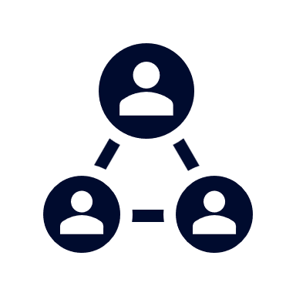



A PARTNER YOU CAN TRUST
OUR OBJECTIVES ARE ALIGNED
WE KNOW THE
MARKET
COMPLETELY TRANSPARENT
WE HAVE THE SOPHISTICATION AND INFRASTRUCTURE TO EFFECTIVELY COMPETE
Derek Moore, Senior Vice President – KBA
845-283-9973 * derek.moore@keybenefit.com

